Slide 1
ULP POD Orientation
(LOADING – DELIVERY – BACKLOAD – POD Submission)

Slide 2
Operation (Principal’s DC)
Loading and Counter at DC Plant
POD (FB Messenger and Store Location)
After UNLOADING Process
Operation (Principal’s DC)
After Delivery
Report to Coordinator (w/ or without Discrepancy)
Take Photo’s of the ff Docs and send to FB Messenger of the corresponding plate # for validation
Loading Guide (must tally and acknowledged by WHSE Checker)
Shipment Document
Sales Invoices
Attachments (DDR/ DN/Cover Letter)
Aux (Mano/ RMR or RTV)
Pallet Docket and Notif Form
Sales invoices/ DN/ Cover Letter w/ Stamp and Sign
DDR fully filled out for DT Accounts
Docs from Different Store:
GRS/ RAR / GR & PO (sign)
GRN / RR/ (Stamp & Sign)
Copy of RDR
POD Submission Must submit all documents for Hard Copies Validation
POD (PLPI Garage)
Delivery with Discrepancy (Short/ Returned rejected items)
RDA = if items returned passed in WHSE Quality Assurance Checking
SDA = Short delivery or items did NOT PASSED in WHSE QA
Pallet Returned/ Abloy (Walter)
Abloy Lock for Waltermart Outlets
Shipdoc with stamp and sign
Pallet Forms with complete stamp and sign
Sales invoices/ DN/ Cover Letter w/ Stamp and Sign
Attachments with Stamp and Signed
Shipdoc’s with complete sign and stamp
Auxiliaries ( All original Copies , validated with sign & Approved by HD

Slide 3
UNILIVER POD
Sample Proof Documents
Sample Auxiliaries
Sample Invoices with Cust rejections

Slide 4
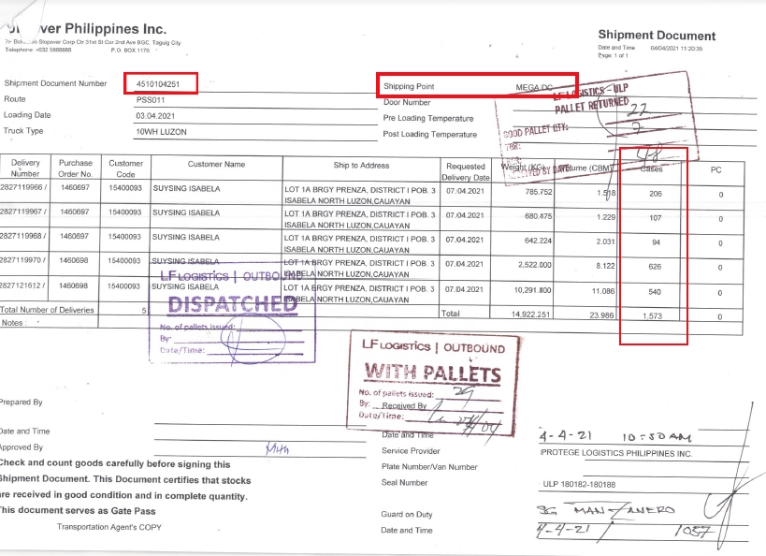
Shipping Documents
Total cases loaded based on PO
Must be signed and stamped before leaving WH premises (eq. Palletes, Guard on duty, etc)

Slide 5
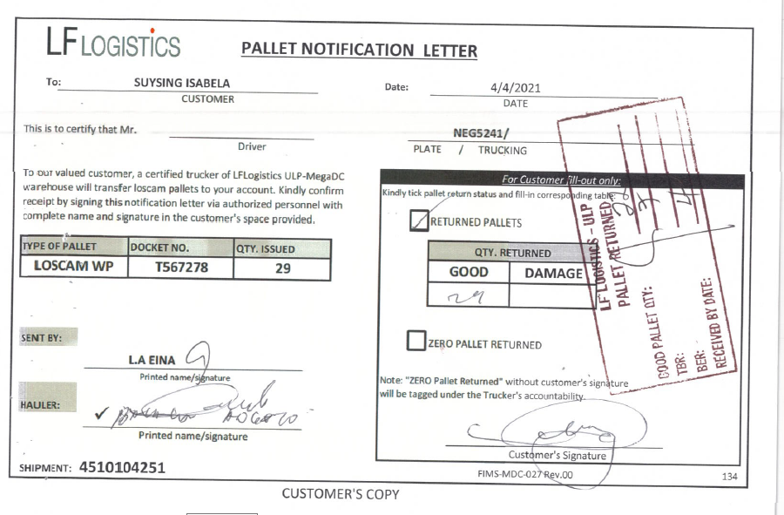
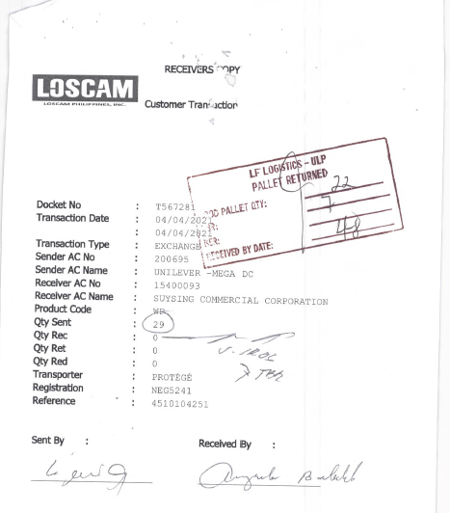
Pallet Docket Form & Noti Letter
Stamped and signed for returned and unreturned pallets
Total number of Pallets borrowed should be the same with the total returned

Slide 6
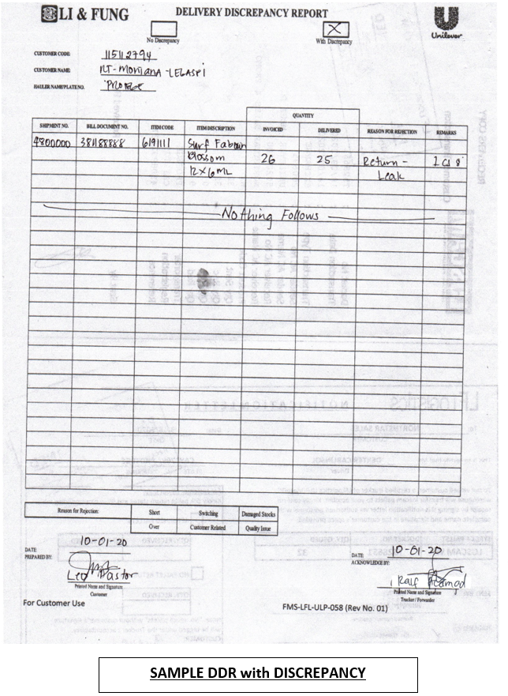
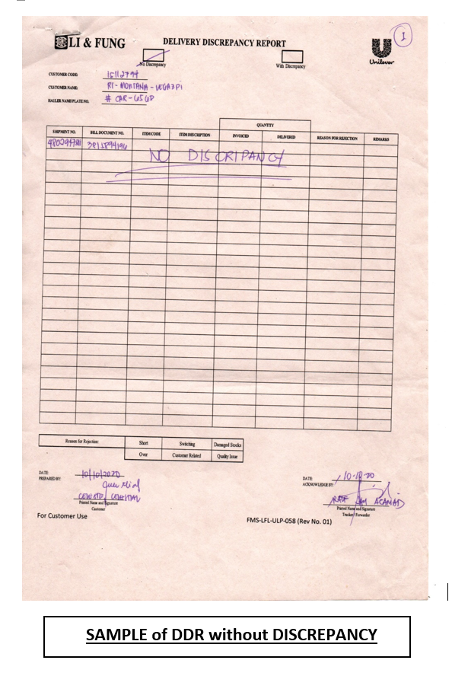
Delivery Discrepancy Report (DDR)
DDR is a requirement for all DT account
1 Invoice = 1 DDR
with or without discrepancy , DDR should be filled-up by Cust

Slide 7
Delivery Discrepancy Report (DDR)

Slide 8
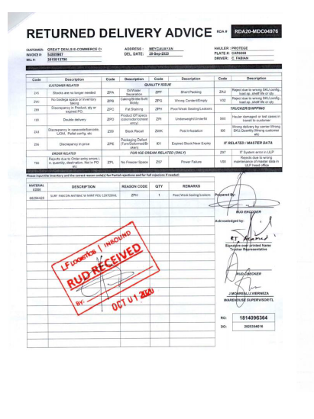
RETURNED DELIVERY ADVICE (RDA)
Documents for items returned that passed Quality Assurance in the warehouse

Slide 9
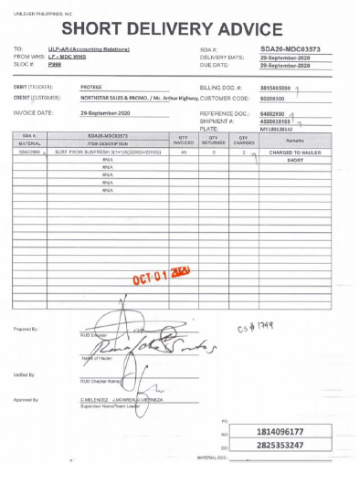
SHORT DELIVERY ADVICE (SDA)
Delivery with short items
Damage items not qualified in Quality Assurance of WH , automatic charges to Hauler

Slide 10
Auxiliaries (explanation and sample)

Slide 11
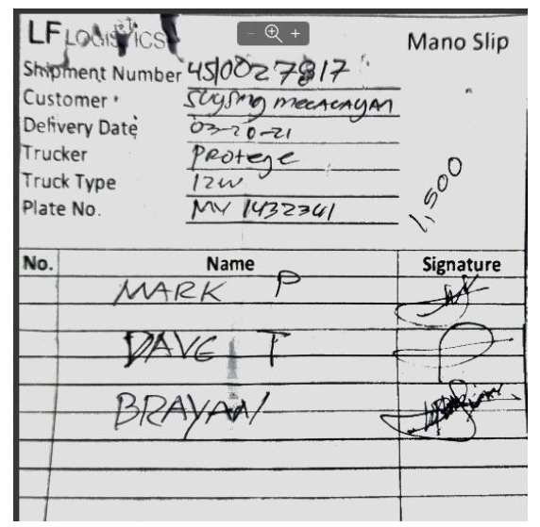
Mano Slip
Mano means “ Additional ManPower”
Every account have diff Mano amount
This is a pre –approved Auxiliary. Must ask approval from Coordinator

Slide 12
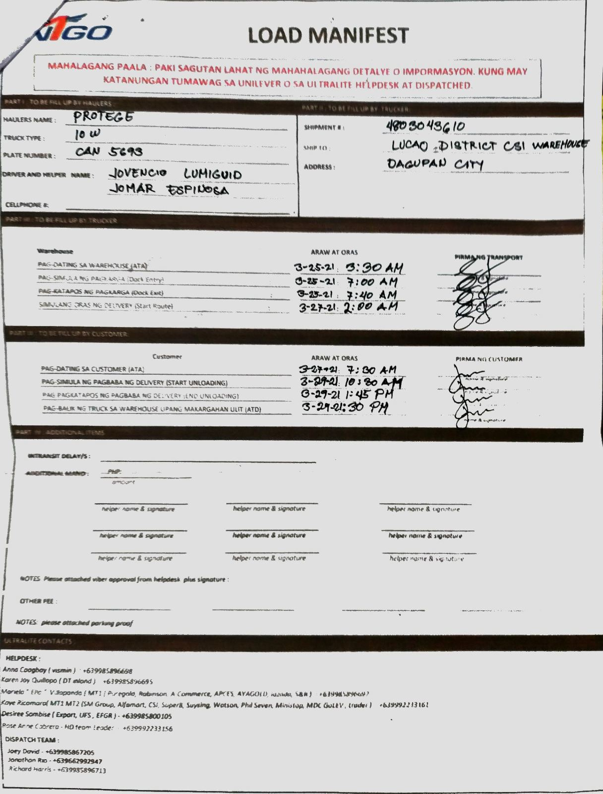
Load Manifest
Form used when claiming Demurage (Customer & WH)
Make sure data are accurate and with Customer signed (Demu Cust)

Slide 13
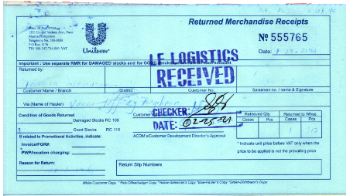
Returned Merchandise Receipt (RMR)
Pre booked

Slide 14
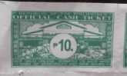
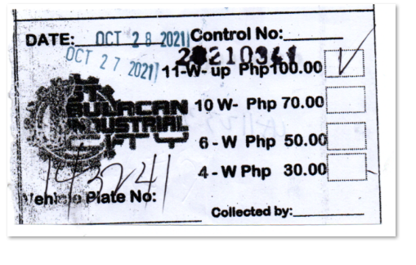
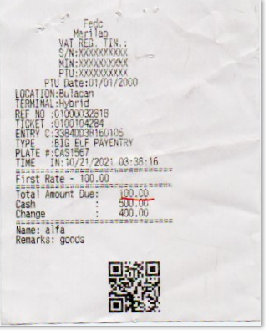
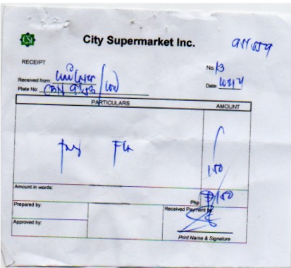
Valid Parking fee Receipts
Pre Approval
Bangketa Receipt not Allowed

Slide 15
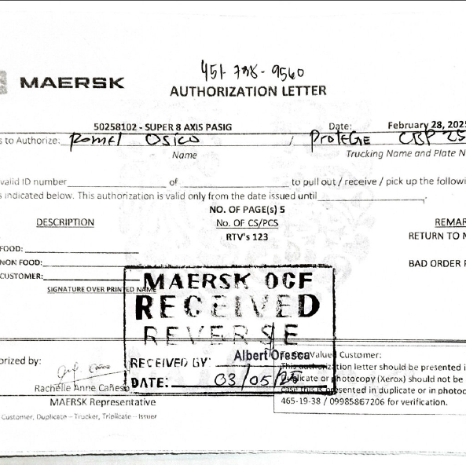
RTV
Pre booked

Slide 16
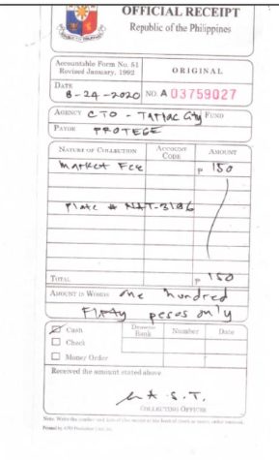
Market Fee
Pre Approval

Slide 17
Proof of Delivery (Sample of Invoices w/ discrepancy and complete received)

Slide 18
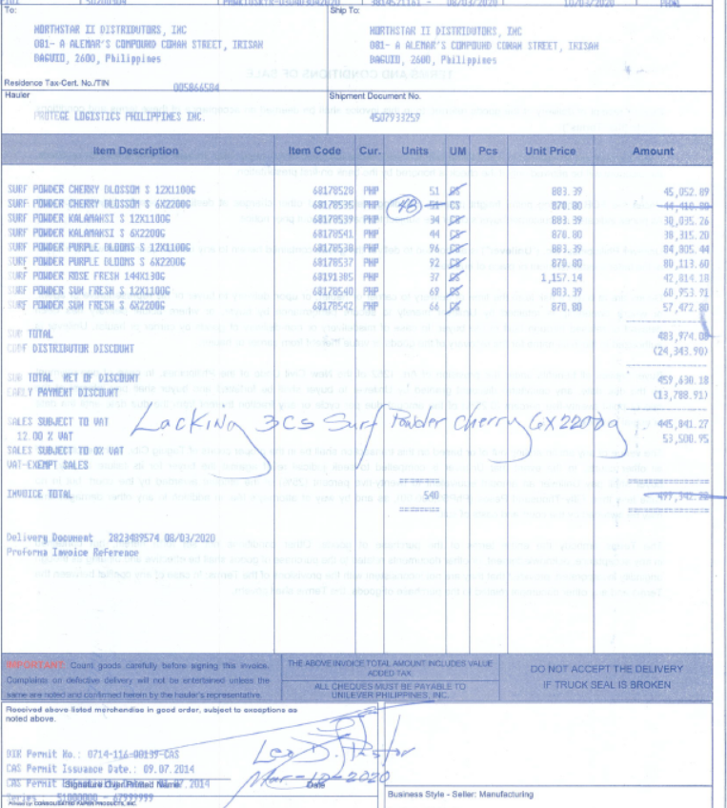
Northstar Baguio - Received if with tick mark every item, Altered invoice qty w/ note of actual cases received. Written Note in actual invoice. DDR Required

Slide 19
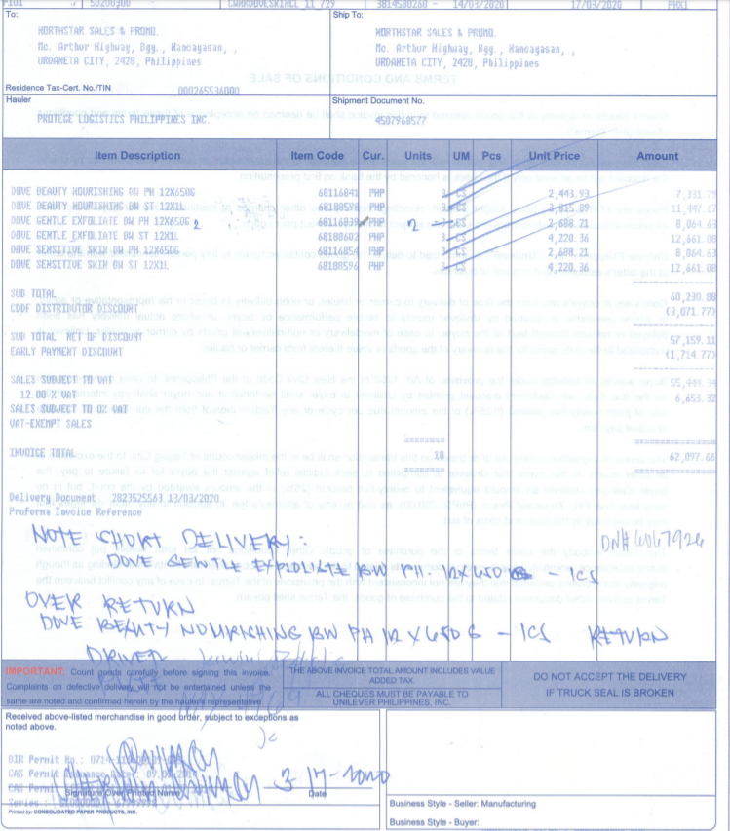
Northstar Urdaneta - Received if with checked every item, Altered invoice qty w/ note of actual cases received. Written Note in actual invoice. DDR Required

Slide 20
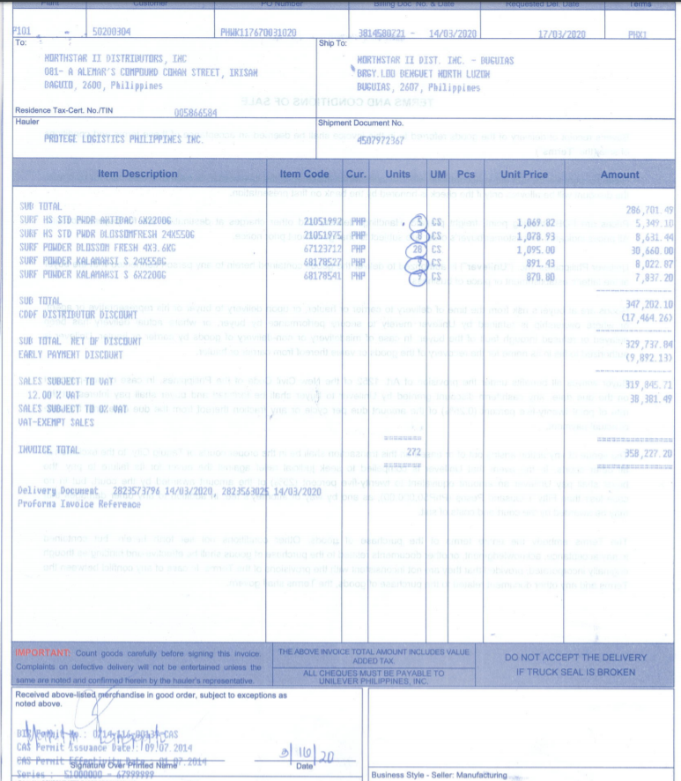
Northstar Buguias - Received encircled item. DDR Required

Slide 21
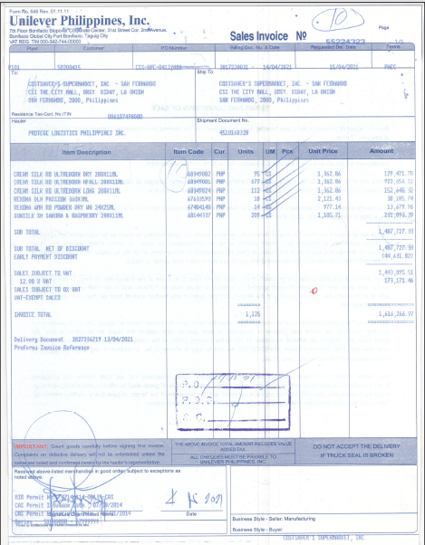
CSI Dagupan- Received if with checked every item, Altered invoice qty w/ note of actual cases received. Written Note in actual invoice

Slide 22
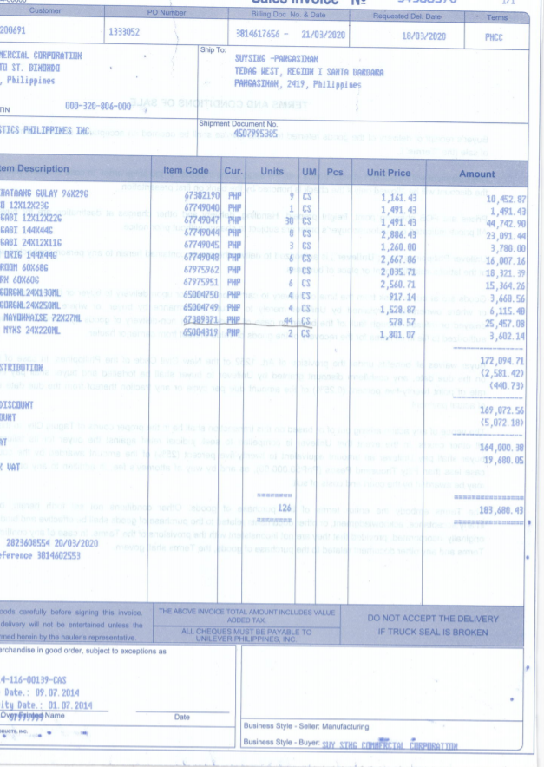
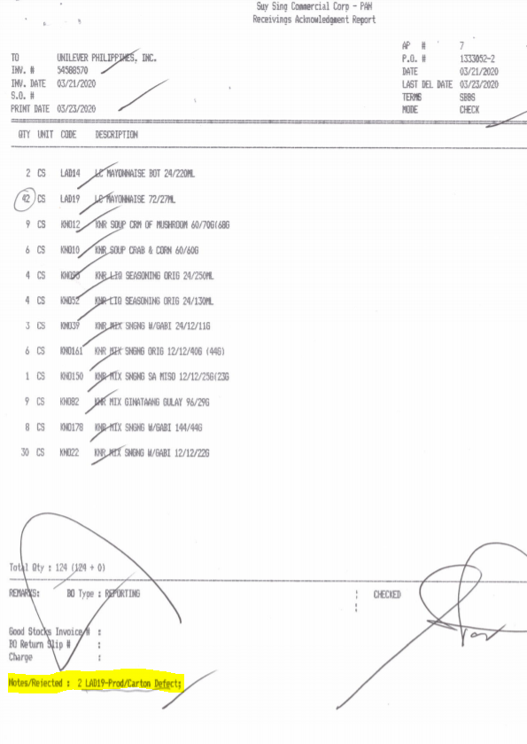
Suysing Pangasinan – RAR provided, for short/over can be found in RAR. No notes in actual invoice.

Slide 23
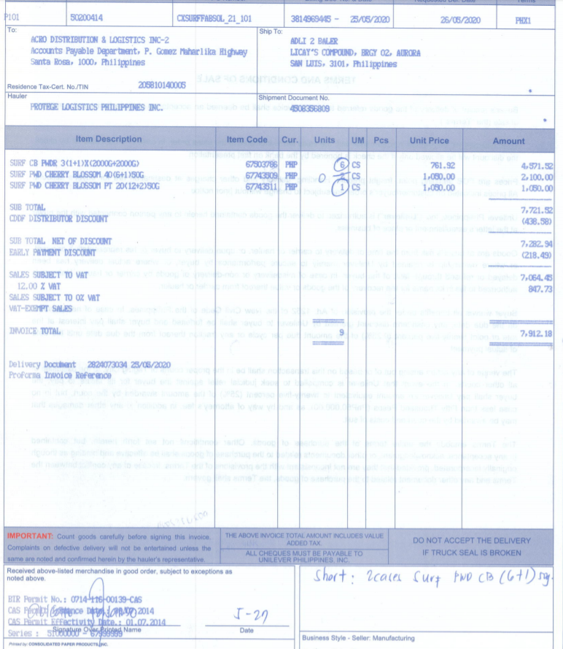
Acro Baler – Received item encircled. For not received items, alteration in cs w/ note of actual number of cases received . DDR Required

Slide 24
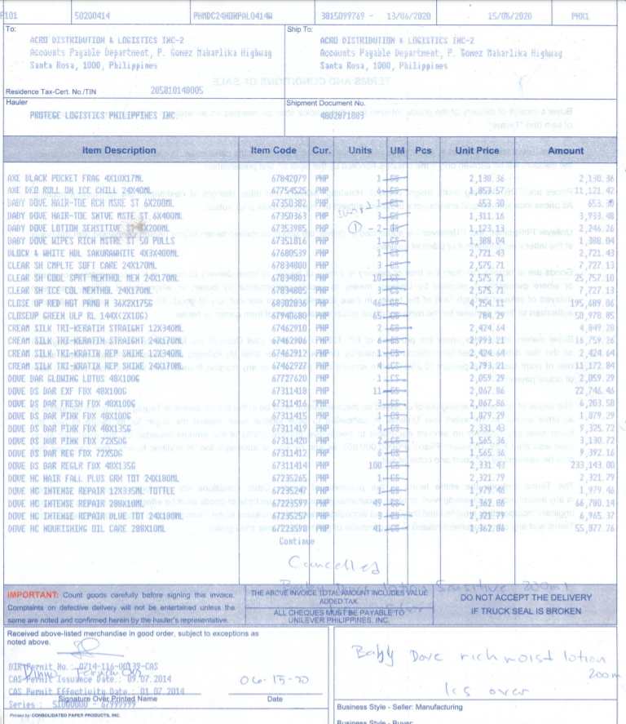
Acro Sta Rosa – Received item w/ tick mark. Not received, written note of actual cases received and description of items short on bottom part of the invoice . DDR Required

Slide 25
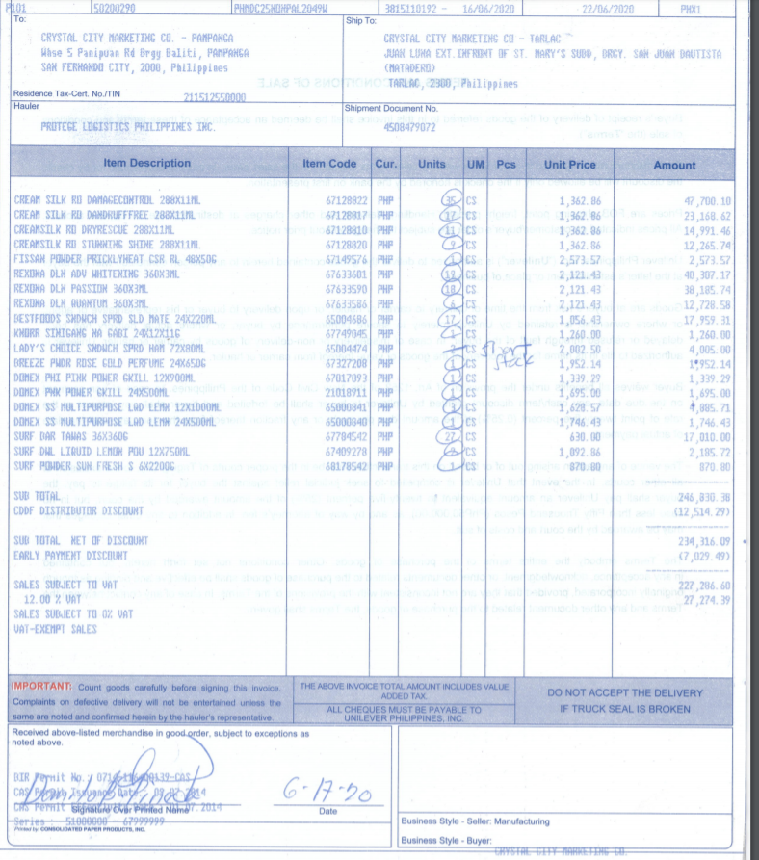
Crystla Tarlac – Received item encircled. Not received, written note of actual cases received. DDR Required

Slide 26
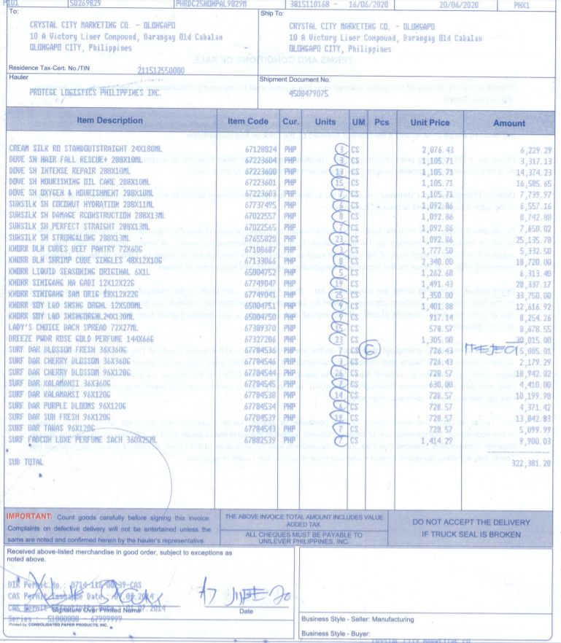
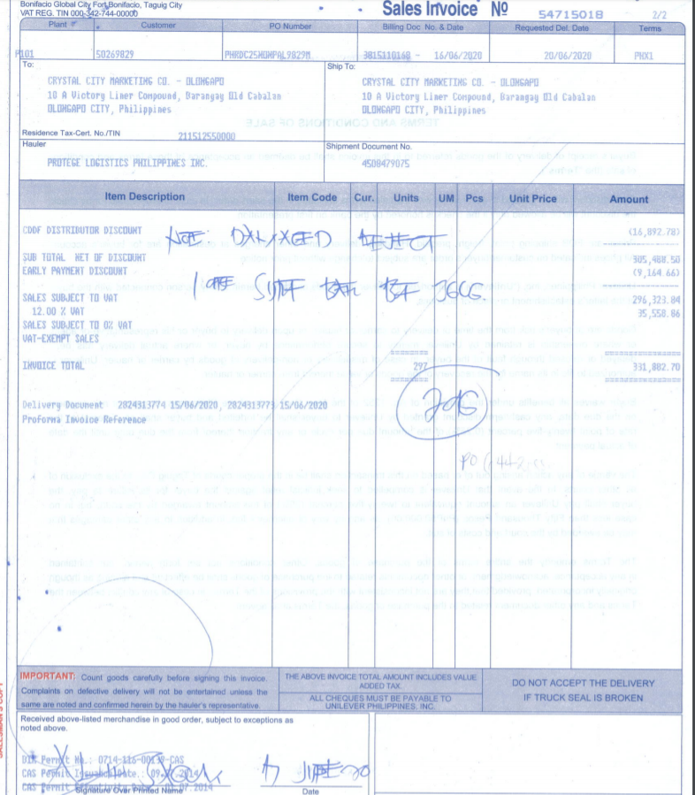
Crystal Olongapo/Iba – Received item encircled. Not received, written note of actual cases received and on bottom part of the invoice. DDR Required

Slide 27
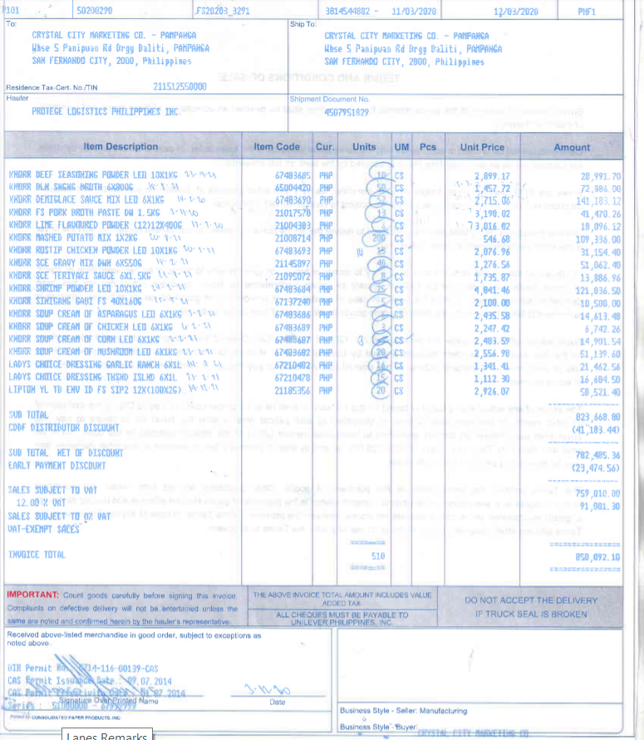
Crystal Pampanga – Received item encircled. Not received, written note of actual cases received. DDR Required

Slide 28
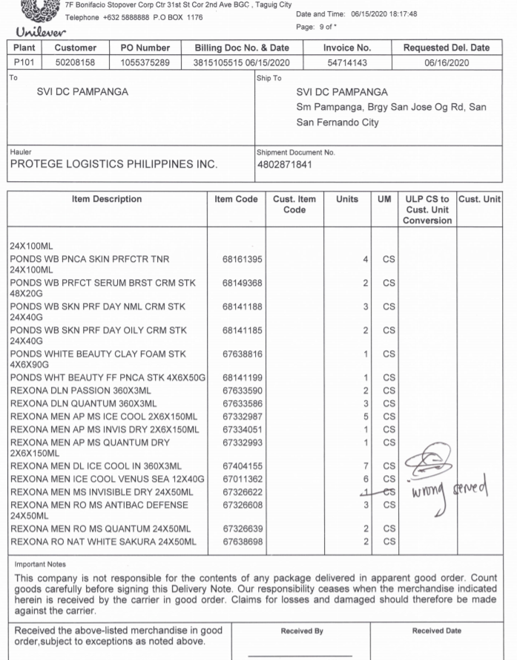
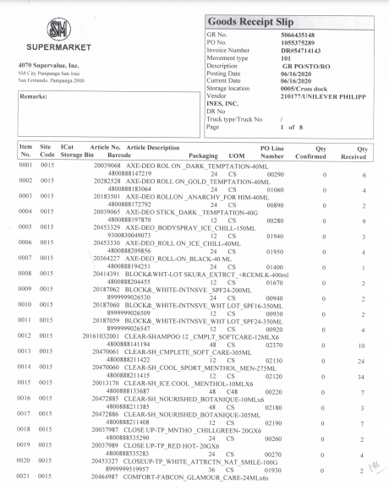
SM Pampanga – Received item w/ GRS. Not received, written note in DN. Invoice serves as an attachment only

Slide 29
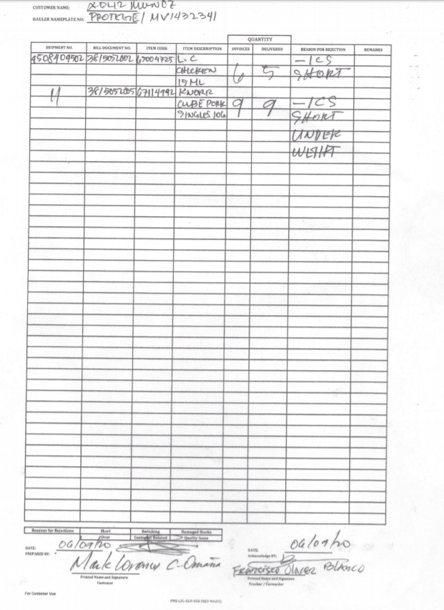
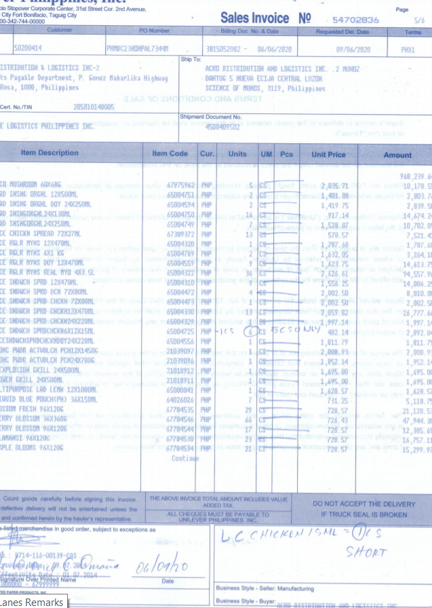
ACRO Munoz– Received item encircled. Not received, written note of actual cases received and on bottom part of the invoice. DDR Required

Slide 30
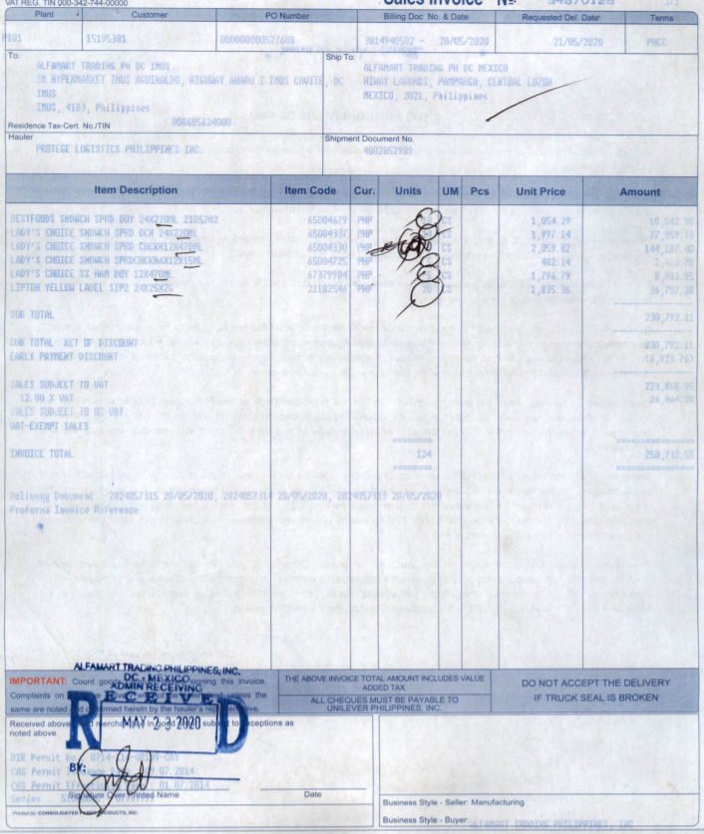
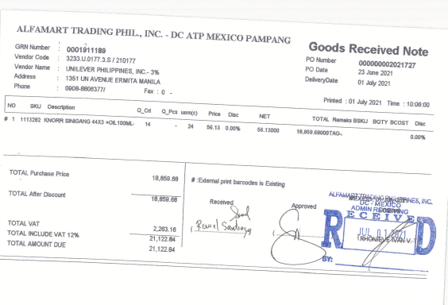
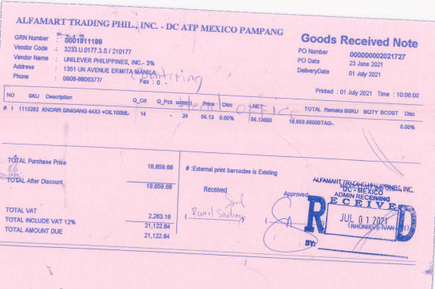
Alfamart – Received item w/ GRN and encircled sa Invoice. Not received, alteration in the inv qty

Slide 31
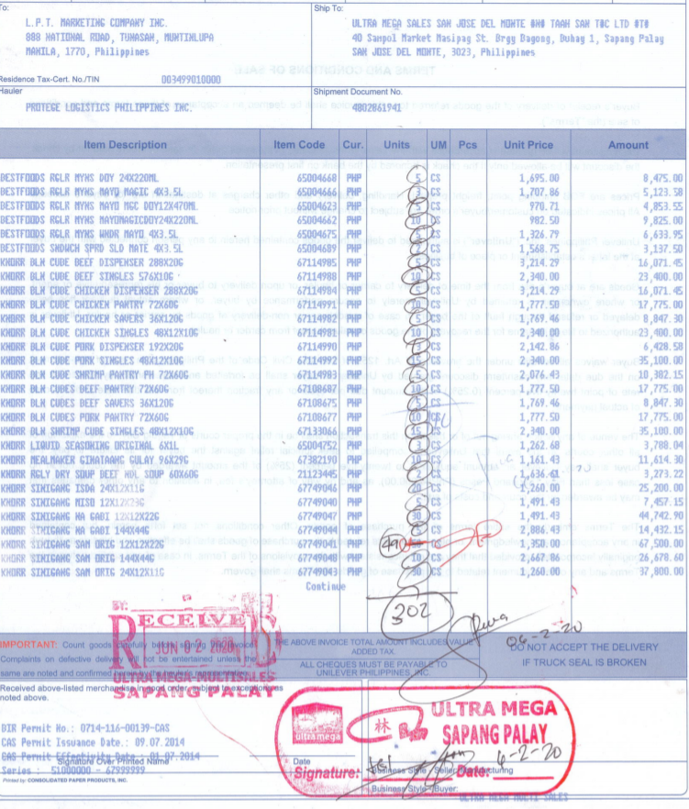
Ultra Mega – Received item encircled. Not received, written note of actual cases received

Slide 32
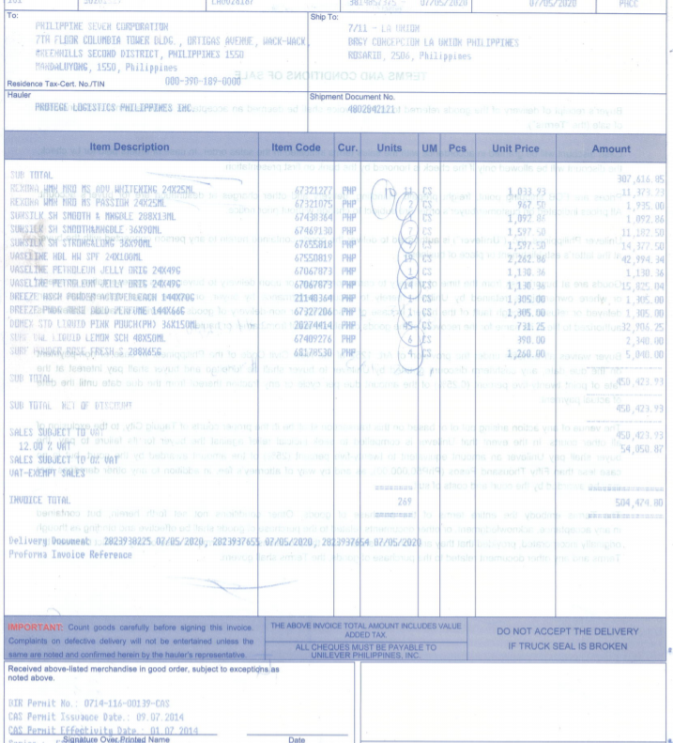
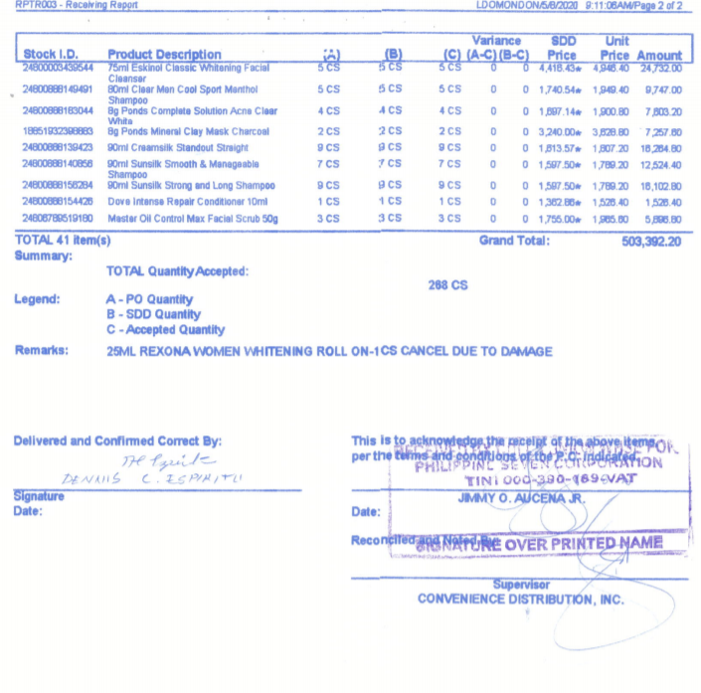
7/11– Received item w/ RR and encircled sa Invoice. Not received, written note of actual cases received

Slide 33
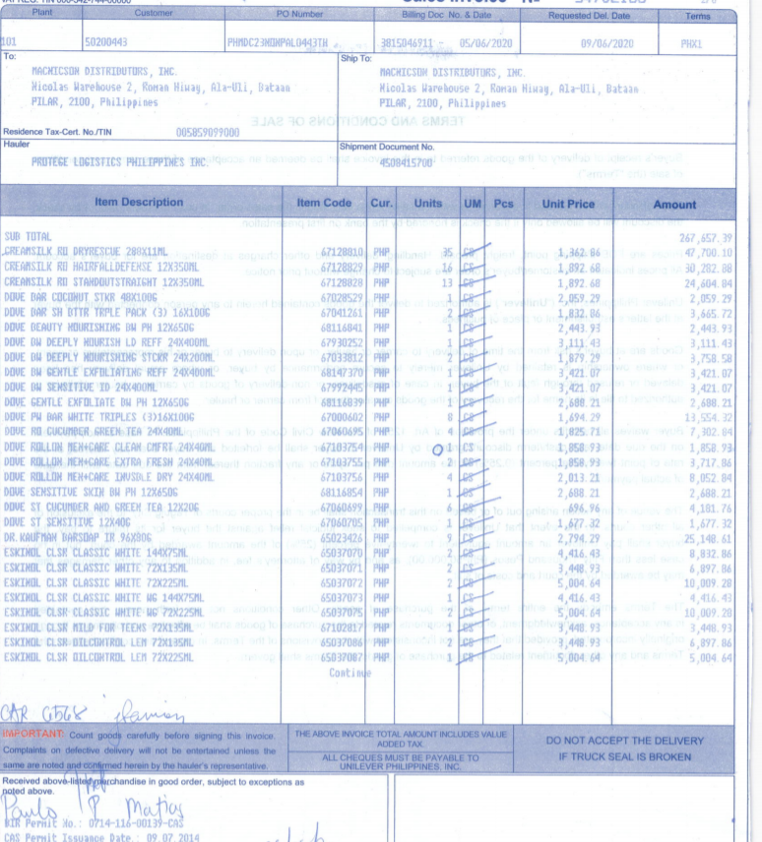
Manicson– Received w/ tickmark. Not received, written note of actual cases received

Slide 34
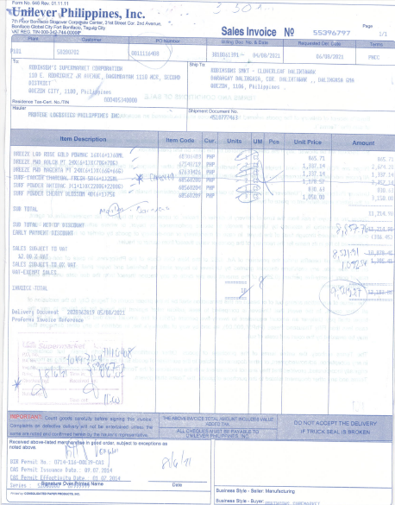
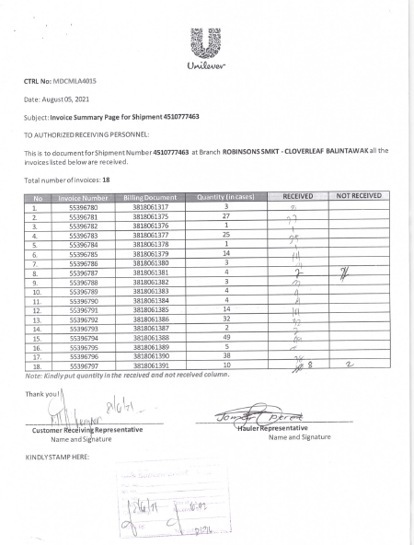
Robinson– Received item encircled. Not received, written note of actual cases received, draw line on the cancelled/short item
COVER LETTER

Slide 35
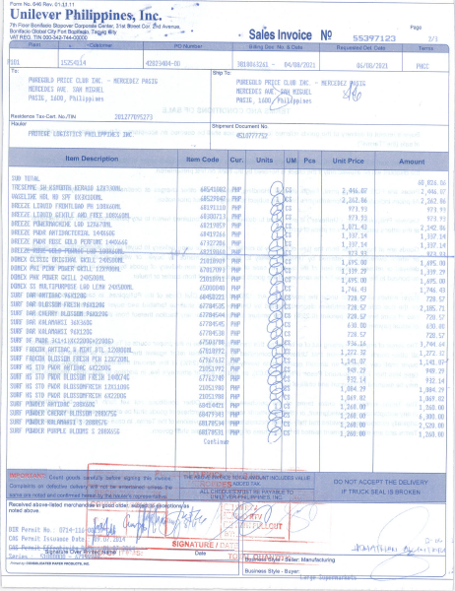
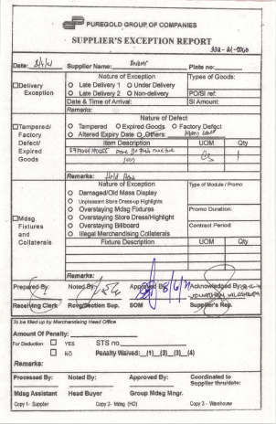
Puregold– Received item encircled. Not received, written note of actual cases received, draw line on the cancelled/short item
CONFISCATION SLIP FRM OUTLET

Slide 36
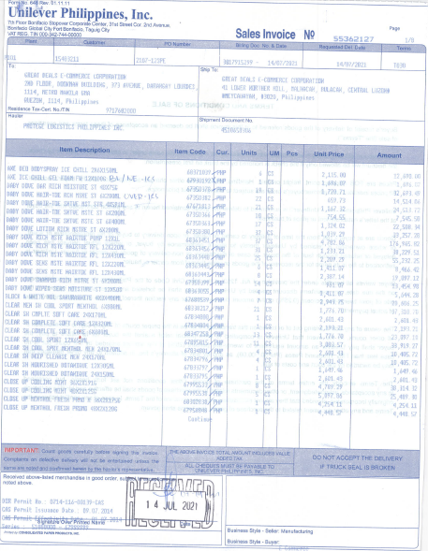
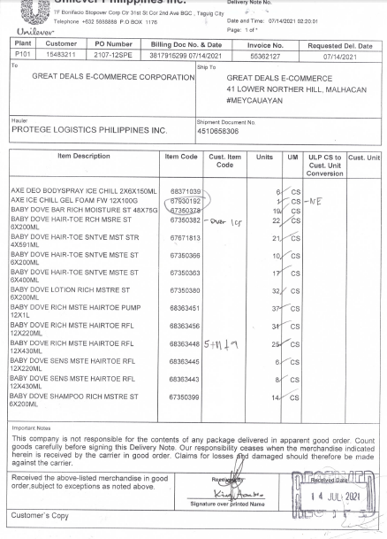
Great Deals – Notes depends on the receiver, No specific Remarks. IR Required

Slide 37
Great Deals – Notes depends on the receiver, No specific Remarks. IR Required

Slide 38
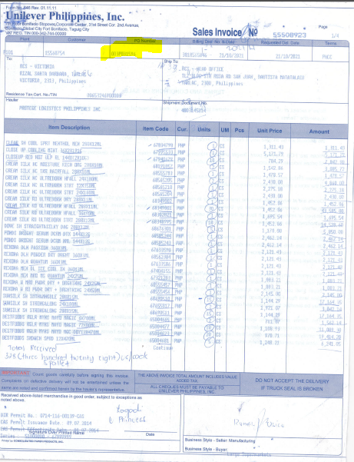
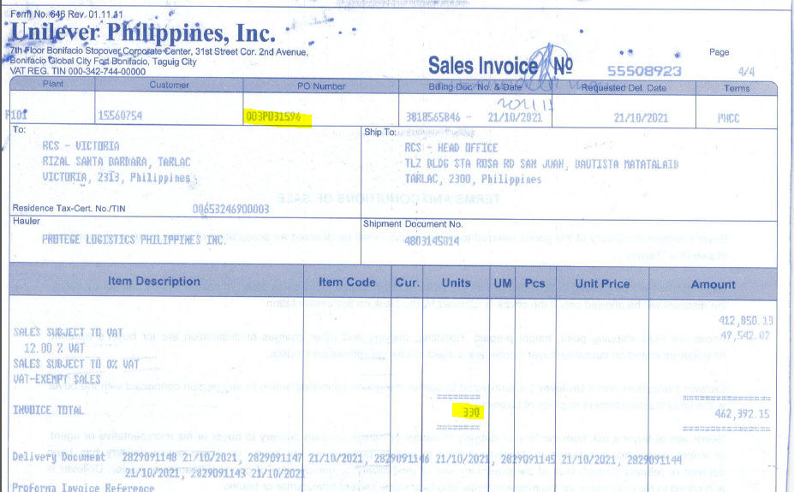
RCS – Notes depends on the receiver; Basic checking is per PO Number in Invoice vs PO Number in GRPO

Slide 39
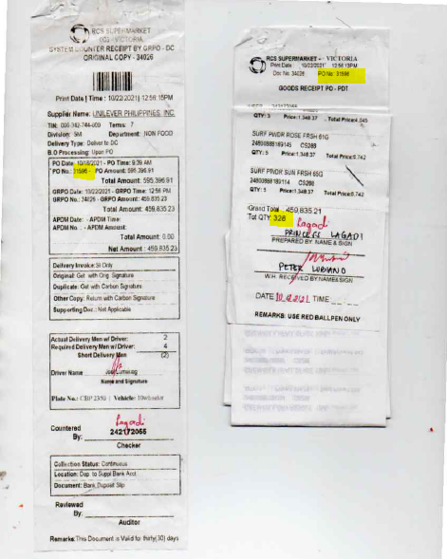
RCS – GRPO quantities must tally with its Invoices with same PO Number
SYSTEM COUNTER RECEIPT FROM RCS
GR PO FROM RCS

Slide 40
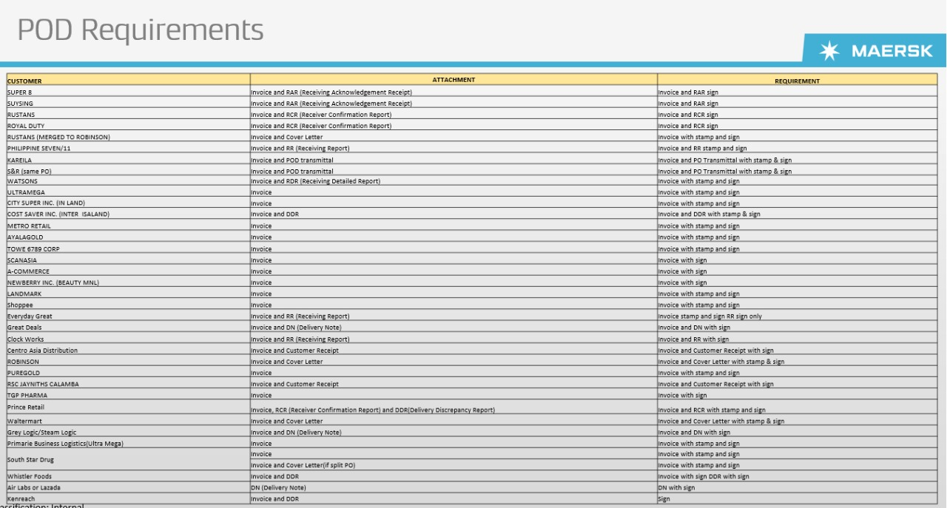

Slide 41
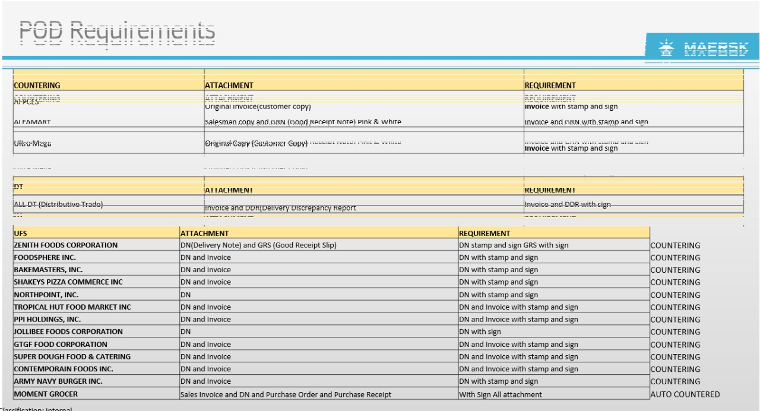

Slide 42


Slide 43
SERVICE COUNTER RECEIPT
Ang mga Subcon partner ay kinakailangang kumuha ng SCR kapag naipasa na ang lahat ng kinakailangang dokumento

Slide 44

48 Hour Rule POD Submission
Ang mga Subcon partner ay kinakailangang magsumite ng lahat ng kinakailangang dokumento pagkatapos ng paghahatid. Ang hindi pagsunod ay magkakaroon ng parusa na P100 bawat invoice, bawat araw ng pagkaantala

Slide 45

Unremitted POD – Auto Charge
Ang POD na hindi naisumite sa loob ng 7 araw (kasama ang Linggo at Sabado) mula sa pagtatapos ng deadline ng pag-unload ay papatawan ng awtomatikong bayarin

